Slide 1

Complex Systems
Anastasia Psarou
Complex Social Systems course lab 5
Summer semester 2024-2025

Slide 2
Complex Systems
A complex system is a system composed of many components which may interact with each other.
The behavior of a complex system is intrinsically difficult to model due to the dependencies, competitions, relationships, and other types of interactions between their parts or between a given system and its environment.

Slide 3
PyCX repository
It is an online repository of simple, crude, easy-to-understand sample codes for various complex systems simulation.
The philosophy of PyCX is on the simplicity, readability, generalizability and pedagogical values of simulation codes.
Clone from here: https://github.com/hsayama/PyCX

Slide 4
PyCX dynamic simulation format
The user needs to define three functions:
Init for initialization.
Draw for visualization.
Step for updating.
And then call pycxsimulator.GUI().start() to run the simulation.

Slide 5
Cellular automation

Slide 6
Cellular automaton
It is a discrete model of computation that consists of a regular grid of cells.
For each cell, a set of cells called its neighborhood is defined relative to the specified cell.

Slide 7
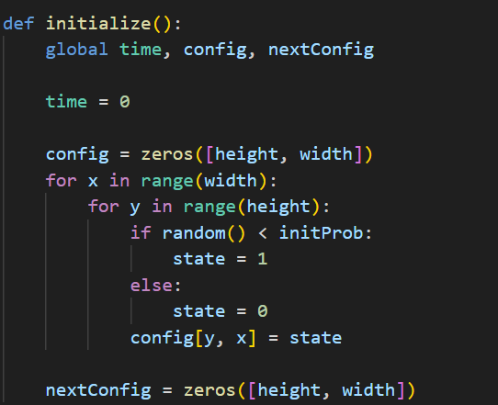
ca-gameoflife.py
Initialize

Slide 8
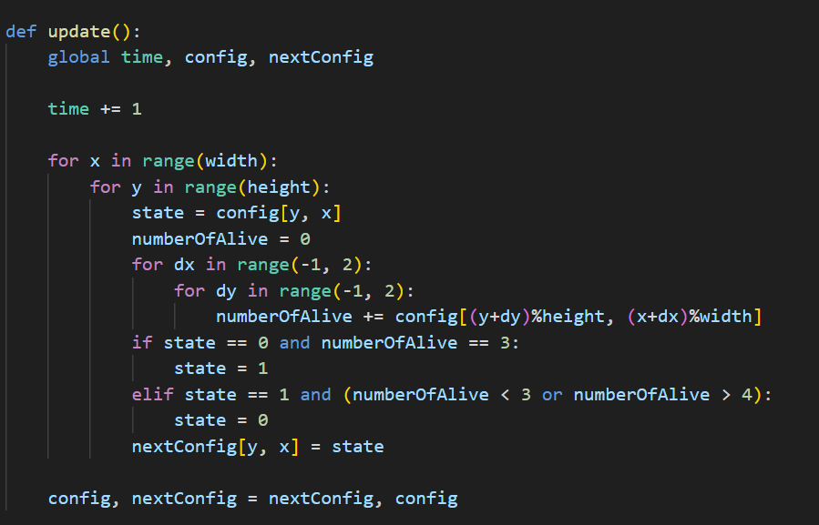
ca-gameoflife.py
update

Slide 9
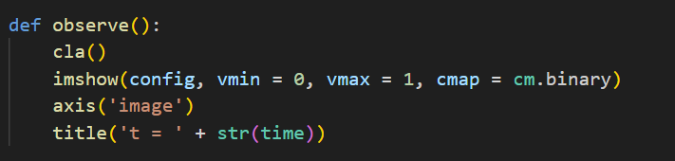
ca-gameoflife.py
OBSERVE

Slide 10
ca-gameoflife.py
SIMULATE

Slide 11
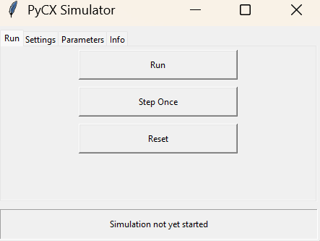
ca-gameoflife.py
Control the simulation

Slide 12
Agent based models

Slide 13
abm-predator-prey-with-plot.py
Two kinds of agents:
Foxes
Rabbits
Parameters of agents:
Foxes:
Initial fox population.
Magnitude of movement of foxes.
Death rate of foxes when there is no food.
Reproduction rate of foxes.
Rabbits:
Initial rabbit population.
Magnitude of movement of rabbits.
Death rate of rabbits when it faces foxes.
Reproduction rate of rabbits.

Slide 14

abm-predator-prey-with-plot.py
If agent is rabbit:
If there are foxes nearby -> with some probability
The rabbit may reproduce themselves with some probability.
If agent is fox:
If there are no rabbits nearby -> with some probability
If there are rabbit nearby (food availability) the foxes may reproduce themselves with some probability.

Slide 15
abm-predator-prey-with-plot.py – Parameter exploration
Investigate how changing different parameters affects the predator-prey dynamics.
What happens to the populations if the reproduction rates of either species are increased?
What parameter values might cause one species to go extinct?

Slide 16
abm-predator-prey-with-plot.py – Introducing third species
What will happen if we introduce wolves that:
move faster compared to foxes and have a higher rabbit-kill rate.
compete with foxes for rabbits, but they may also attack foxes in proximity.
Questions:
Under what conditions can all three species coexist?
What happens if wolves and foxes have the same movement rate and reproduction rate?

Slide 17
Networks

Slide 18
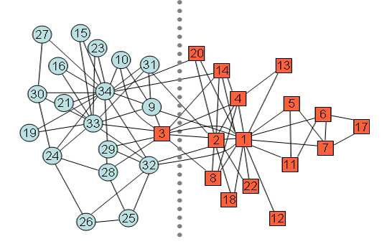
Zachary’s karate club
It is a social network of a university karate club.
It captures 34 members of a karate club, documenting links between pairs of members who interacted outside the club.
A conflict arose between the administrator “John A” and instructor “Mr. Hi”, which led to the split of the club into two.
Half of the members formed a new club around Mr. Hi and the rest of the members gave up karate.
W. W. Zachary, “An Information Flow Model for Conflict and Fission in Small Groups,” Journal of Anthropological Research, Vol. 33, 1977, pp. 452-473.

Slide 19
Zachary’s karate club
Each node has an attribute ‘club’ that indicates the name of the club to which the member represented by that node belongs to.
Each edge has a weight based on the number of contexts in which that edge’s incident node members interacted.
W. W. Zachary, “An Information Flow Model for Conflict and Fission in Small Groups,” Journal of Anthropological Research, Vol. 33, 1977, pp. 452-473.

Slide 20
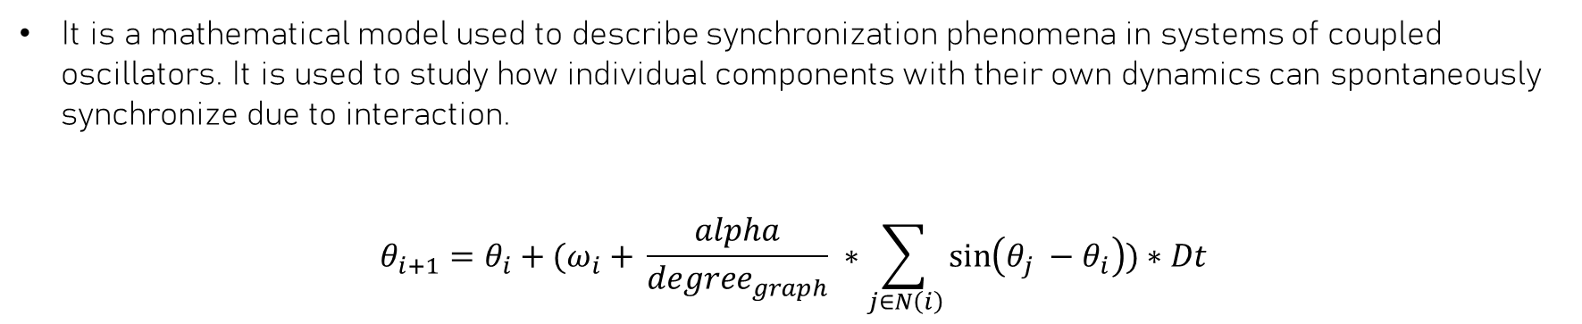
The Kuramoto model
It is a mathematical model used to describe synchronization phenomena in systems of coupled oscillators. It is used to study how individual components with their own dynamics can spontaneously synchronize due to interaction.
$$θ_{i+1}=θ_{i}+{(ω}_{i} + \frac{alpha}{{degree}_{graph}} ∗\sum_{j∈N\left(i\right)}{\sin\left(θ_{j} −θ_{i}\right)})∗Dt$$
W. W. Zachary, “An Information Flow Model for Conflict and Fission in Small Groups,” Journal of Anthropological Research, Vol. 33, 1977, pp. 452-473.

Slide 21
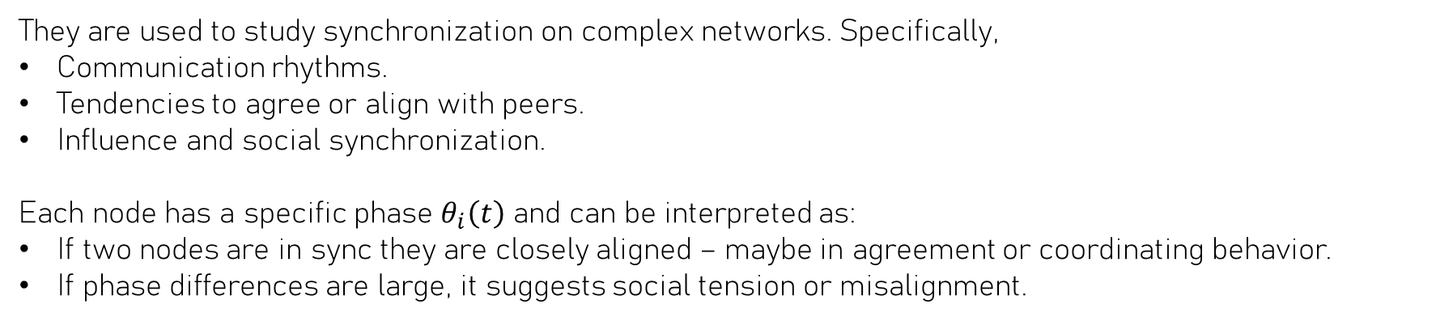
The Kuramoto model and the Zachary Karate Club graph
They are used to study synchronization on complex networks. Specifically,
Communication rhythms.
Tendencies to agree or align with peers.
Influence and social synchronization.
Each node has a specific phase $θ_{i}\left(t\right)$ and can be interpreted as:
If two nodes are in sync they are closely aligned – maybe in agreement or coordinating behavior.
If phase differences are large, it suggests social tension or misalignment.

Slide 22
net-kuramoto-with-phase.py
How does increasing alpha affects the speed and degree and synchronization?
What happens when alpha=0?

Slide 23
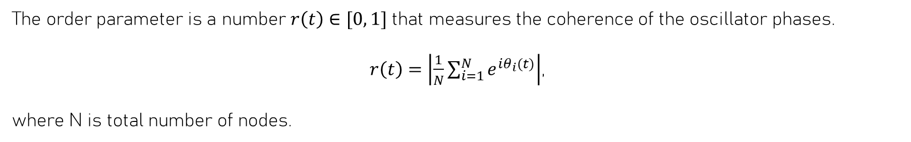
net-kuramoto-with-phase.py – order parameter
The order parameter is a number $r\left(t\right)∈[0, 1]$ that measures the coherence of the oscillator phases.
$r\left(t\right)=\left|\frac{1}{N}\sum_{i=1}^{N}{e^{iθ_{i}(t)}}\right|$,
where N is total number of nodes.

Slide 24
Thanks!

